Slide 1

digital music store analysis
Using PostgreSQL

Slide 2
Project Objective:
It is a digital music store sales analysis project. I analyze and query the data sets using facts, metrics, and data to guide strategic business decisions that align with your goals, objectives, and initiatives.
For example here I extracted meaningful information such as total invoices, best customers, popular artists, tracks, etc.

Slide 3
About the project :
Utilized PostgreSQL to extract data from 11 different related tables from music store databases using JOIN and VIEW
Transformed and filtered data by using aggregating and filtering functions to improve the reporting process
Write 11 queries to extract meaningful insights from the datasets and use them to make the final report
Used window function, joins, cte, subquery formed schema or data model using foreign key for query the database appropiately
Loaded all information into PowerPoint to represent key business intelligence that can improve sales performance

Slide 4

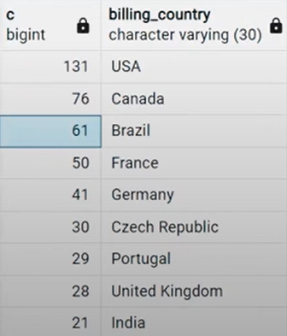
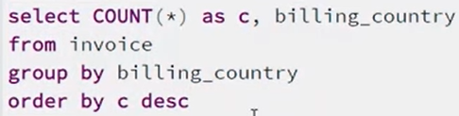
Q1: Who is the senior most employee based on job title?
Q2: Which countries have the most Invoices?

Slide 5

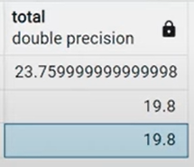
Q3: What are the top 3 values of the total invoice?

Slide 6
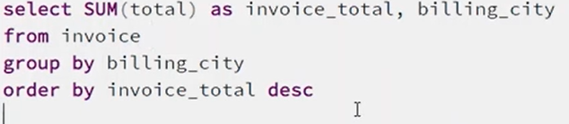
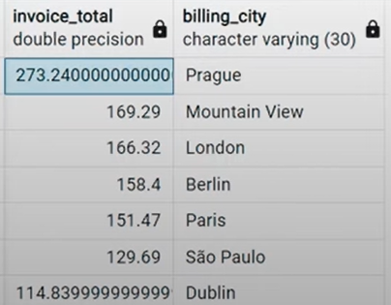
Q4: Which city has the best customers? We want to throw a promotional Music Festival in the town where we make the most money. Write a query that returns one city that has the highest sum of invoice totals. Return both the city name & sum of all invoice totals

Slide 7
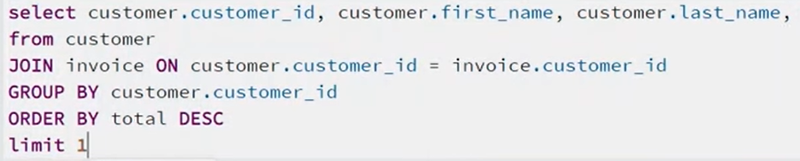
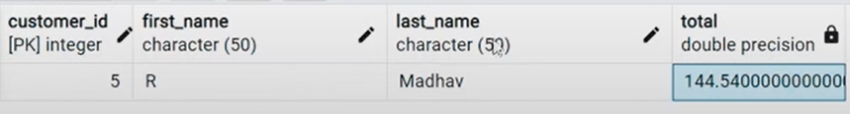
Q5: Who is the best customer? The customer who has spent the most money will be declared the best customer. Write a query that returns the person who has spent the most money.

Slide 8
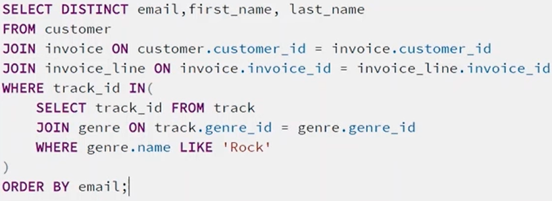
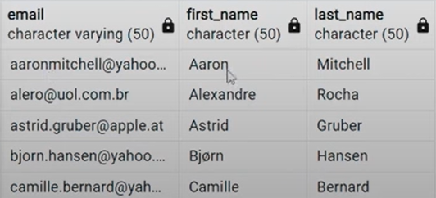
Q6: Write a query to return the email, first name, last name, & Genre of all Rock Music listeners. Return your list ordered alphabetically by email starting with A.

Slide 9
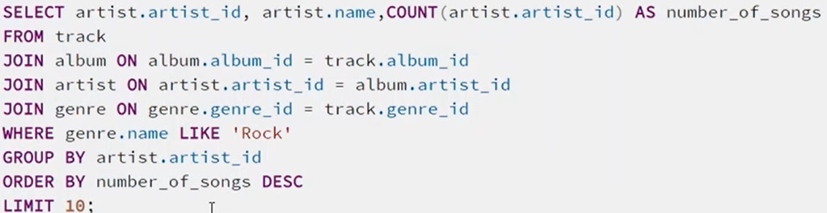
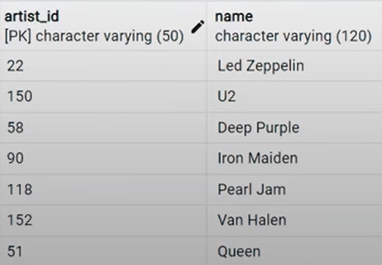
Q7: Let's invite the artists who have written the most rock music in our dataset. Write a query that returns the Artist name and total track count of the top 10 rock bands.

Slide 10
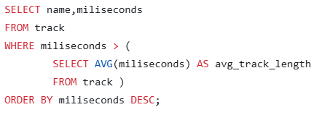
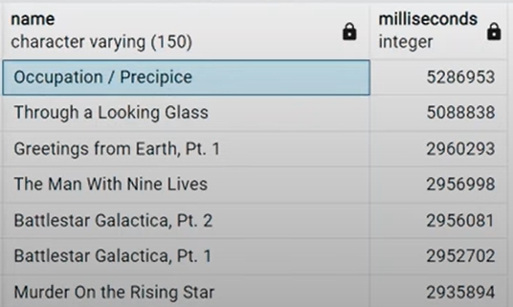
Q8: Return all the track names that have a song length longer than the average song length. Return the Name and Milliseconds for each track. Order by the song length with the longest songs listed first.

Slide 11
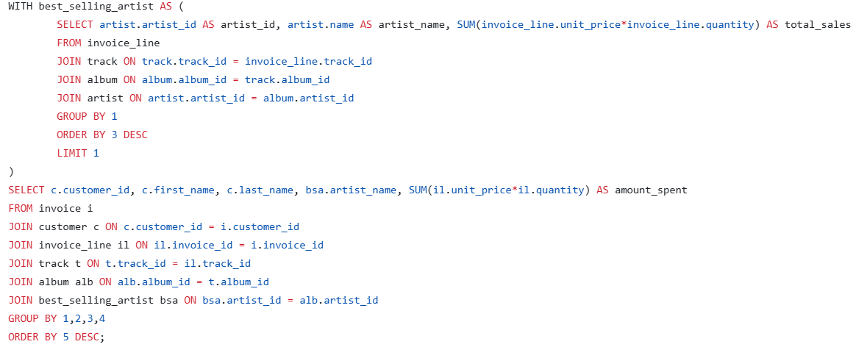
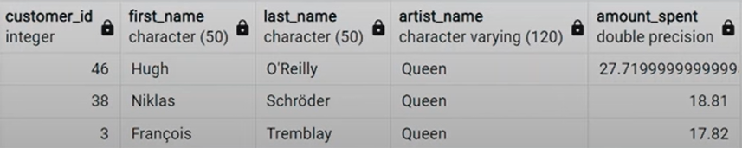
Q9: Find how much amount spent by each customer on artists. Write a query to return the customer name, artist name, and total spent

Slide 12
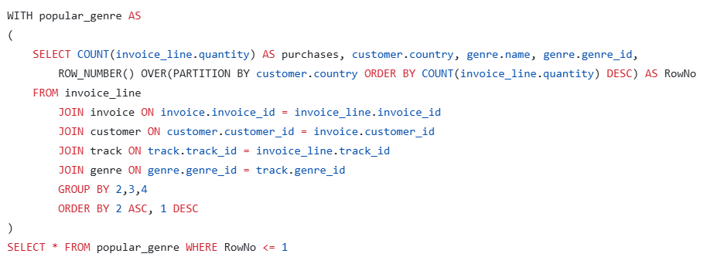
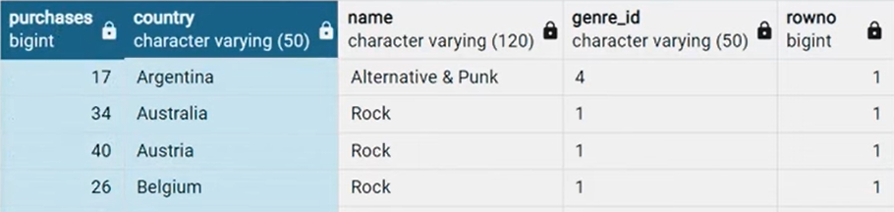
Q10: We want to find out the most popular music Genre for each country. We determine the most popular genre as the genre with the highest amount of purchases. Write a query that returns each country along with the top Genre. For countries where the maximum number of purchases is shared return all Genres.

Slide 13
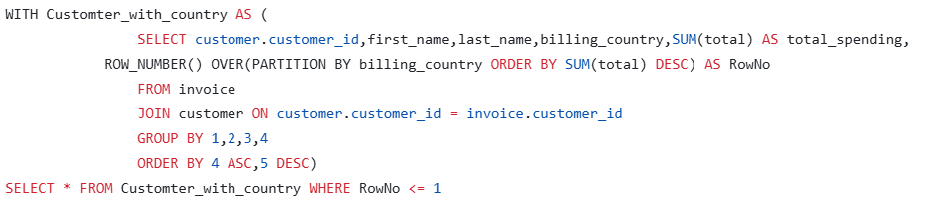
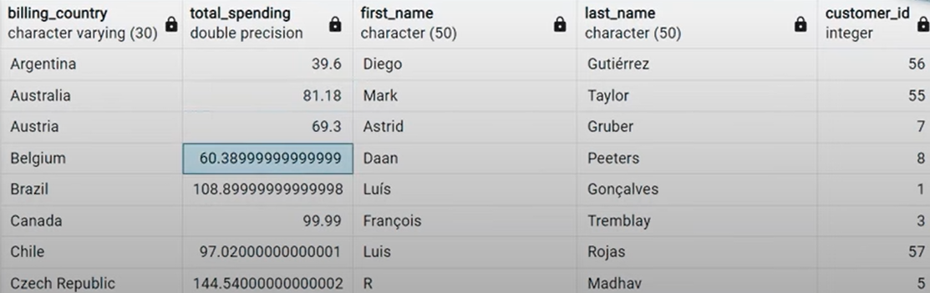
Q11: Write a query that determines the customer that has spent the most on music for each country. Write a query that returns the country along with the top customer and how much they spent. For countries where the top amount spent is shared, provide all customers who spent this amount.

Slide 14
THANK YOU

